Slide 1

DECISION SUPPORT SYSTEM FOR LIVER TRAUMA ASSESSMENT USING CT IMAGES
Ph.D Proposal Presentation by
Cauvery K
Reg. No.: 230900225
Department of Computer Science and Engineering,
Manipal Institute of Technology, Manipal
Under the supervision of
Dr. P.C. Siddalingaswamy
Professor (Guide)
Department of CSE,
Manipal Institute of Technology, Manipal
Dr. Prakashini K
Professor (Co-Guide)
Department of Radiodiagnosis,
Kasturba Medical College, Manipal
Dr. Sanjay Singh
Professor (Co-Guide)
Department of ICT,
Manipal Institute of Technology, Manipal
Nov 05, 2024

Slide 2
Presentation Overview
Introduction
Literature Review
Research Gaps
Objectives
Methodology
Expected Outcomes
Importance of Proposed Research Investigation
Research Time Plan
Pilot Study/Preliminary Work Done
Expenses and Funding
References
Course Work Details

Slide 3
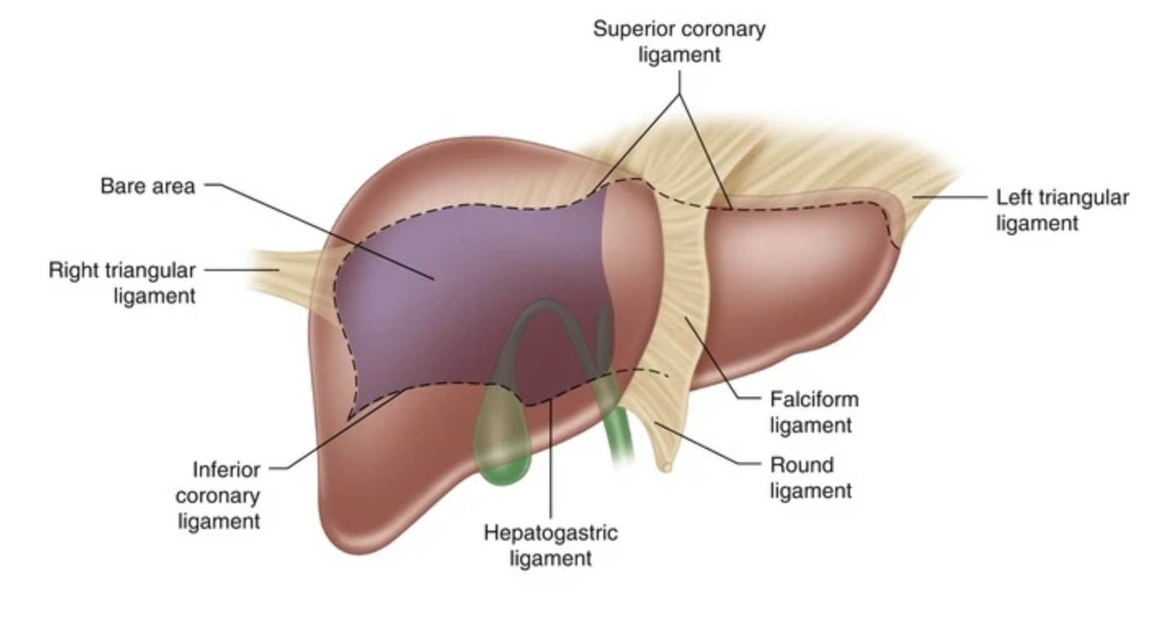
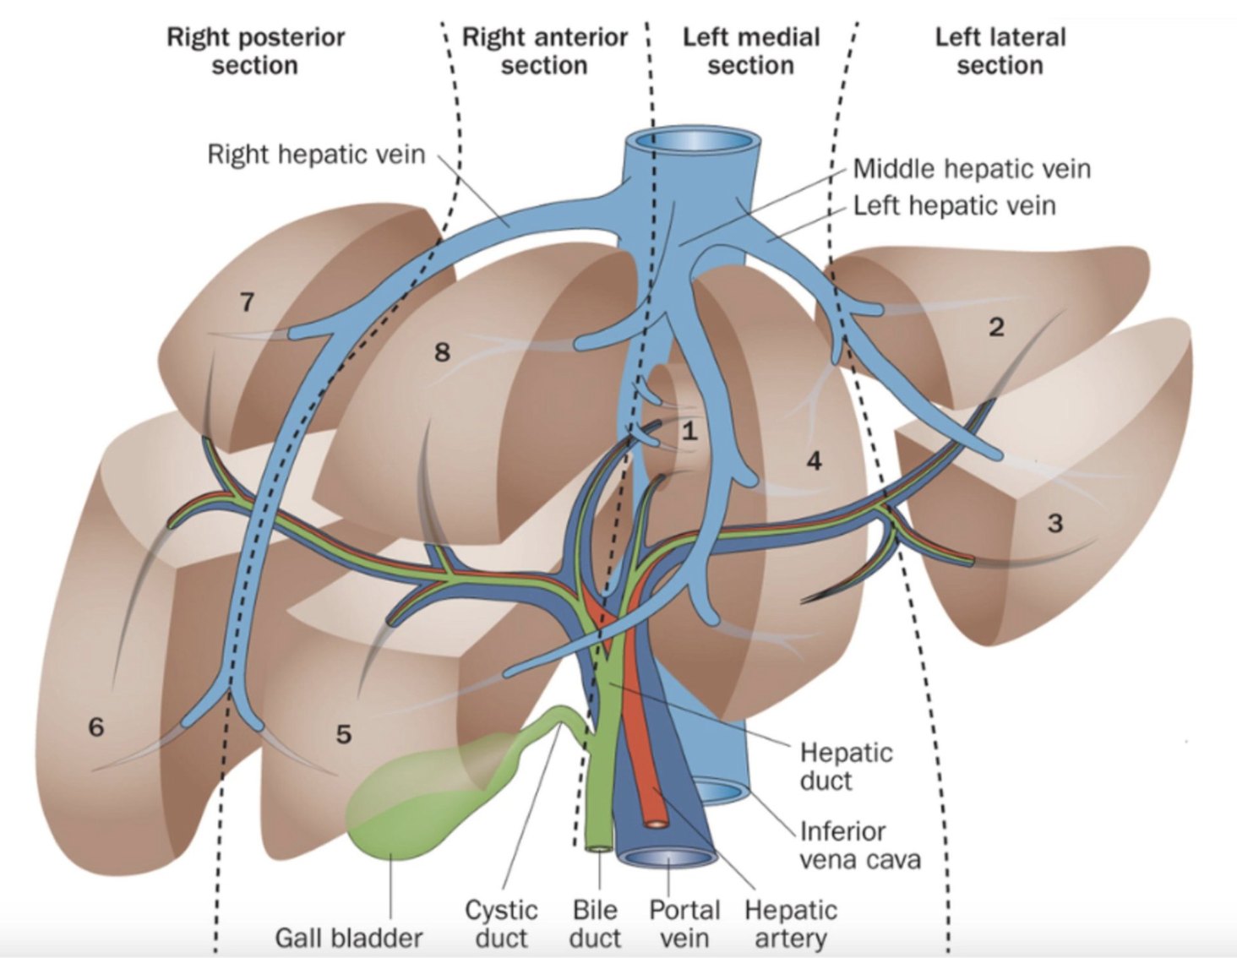
Introduction-I
Why liver is prone to trauma? [1-8]
Largest peritoneal abdominal organ in the human body
Location and Size:
Situated in the RUQ
~2-3% total body mass
Fixed position (falciform, coronary, triangular ligaments)
Fragility:
Covered by thin fibrous capsule (Glisson capsule)
Fragile parenchyma (liver tissue)
Vascularity:
Dual blood supply
Hepatic artery (25%), Portal vein (75%)
High blood flow, haemorrhage
Biliary tree disruption
Figure 1.1: Liver Anatomy.
(Source:https://link.springer.com/chapter/10.1007/978-1-4939-1200-1_1)
Figure 1.2: Liver segmented along Canauid
(Source:https://ilts.org/insights/couinauds-segmental-anatomy-of-the-liver-and-proposed-classification-of-pediatric-liver-tumors/)

Slide 4
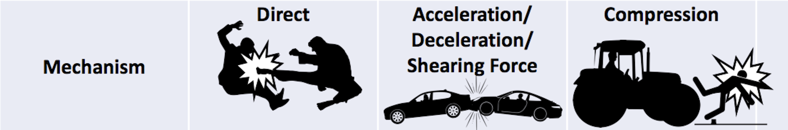
Introduction-II: Mechanism of Injury
Mechanism of injury [9-12]
Blunt trauma
Acceleration-deceleration, compression
Eg: MVA, pedestrian accidents, falls, sports, fights
Penetrating trauma
Perforating force
Eg: Stabbing, gunshot, shear forces
Right lobe of the liver most affected
Figure 1.3: Mechanisms of Injury
(Source:https://en.m.wikipedia.org/wiki/File:Common_Blunt_Thoracic_Injuries.png

Slide 5
Introduction-III:Statistics
Liver Trauma Statistics [13-17]
LMICs like India contribute to 90% of all the global injury burden
RTA main cause
~5% of all trauma admissions
Blunt trauma
80% of the abdominal trauma
35-45% are liver trauma
Penetrating trauma
40% SWs and 30% GSWs
More prevalent in countries prone to civil unrest.
Eg: USA, South Africa, Middle East
Primary cause of death in severe abdominal trauma, 10-15% mortality rate

Slide 6
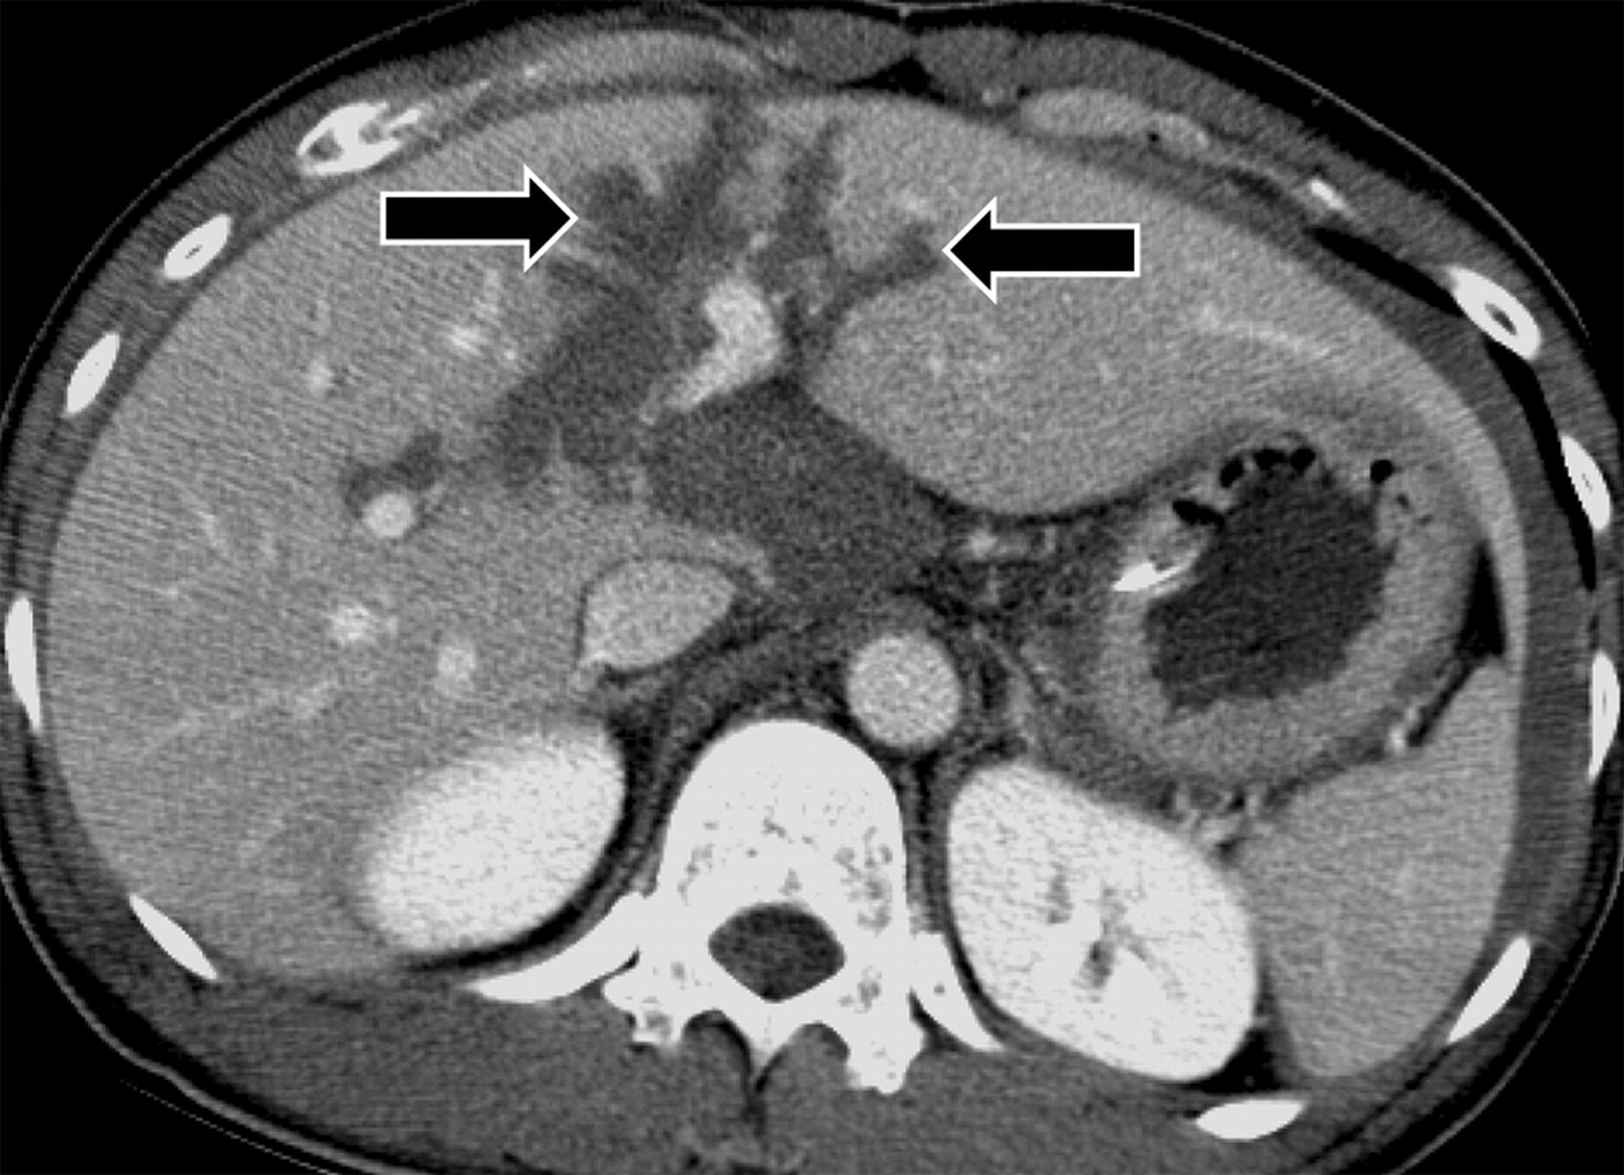
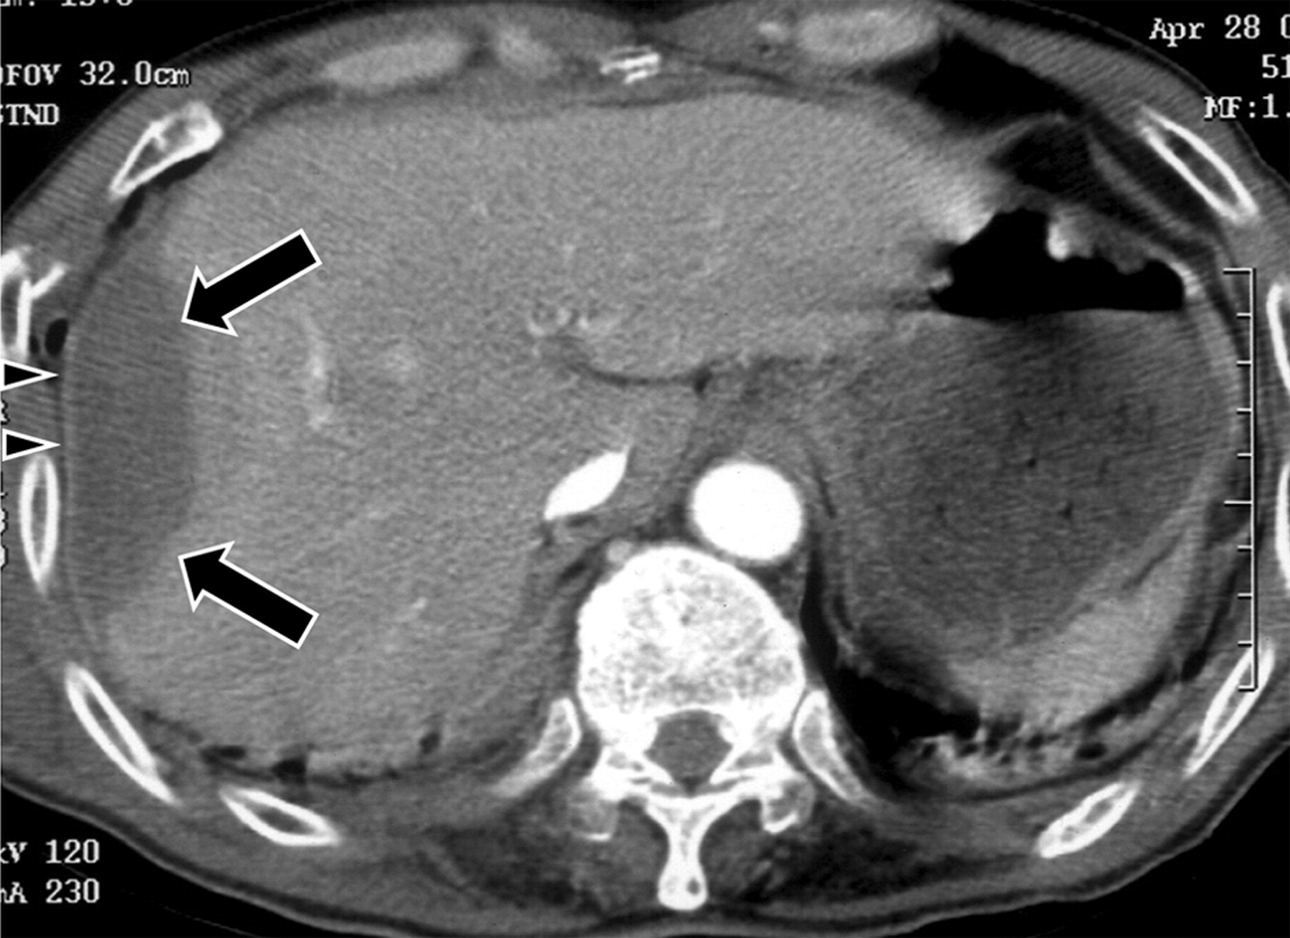
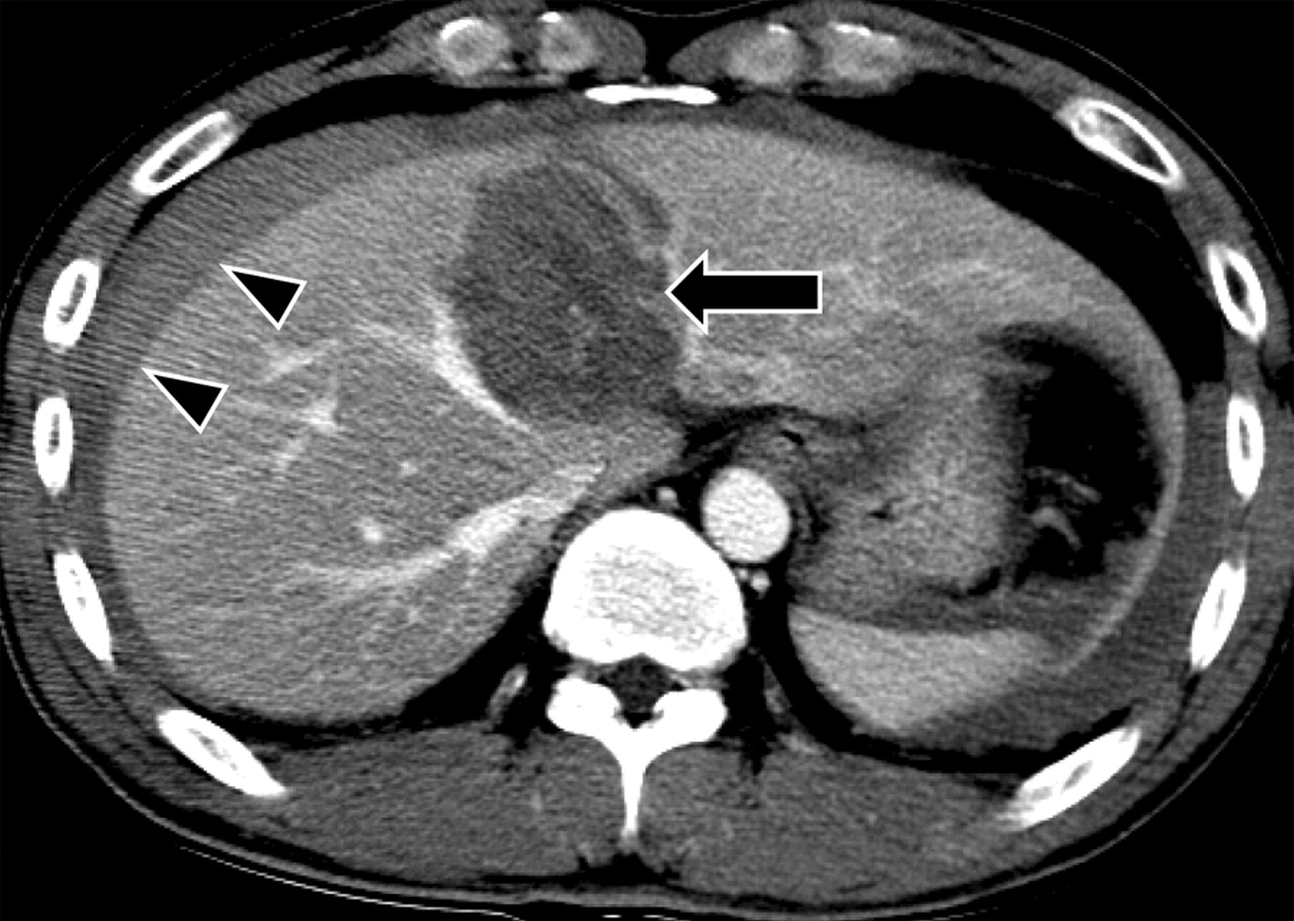
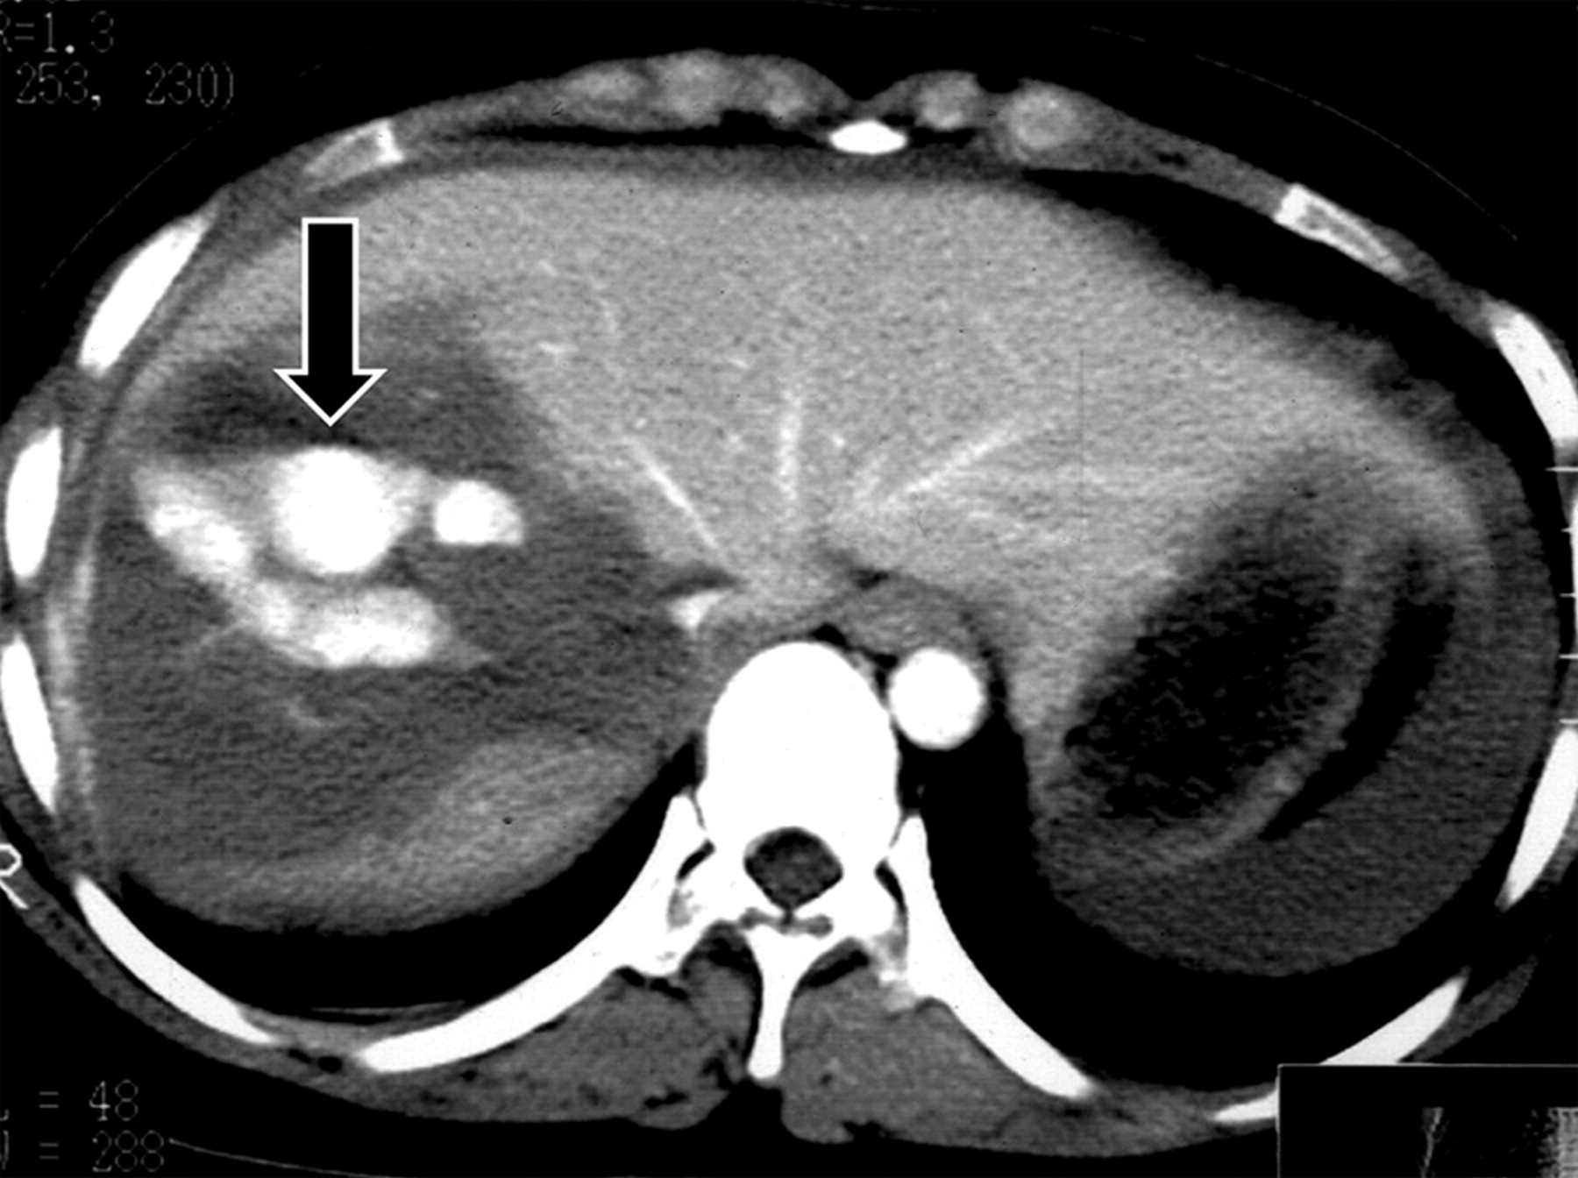
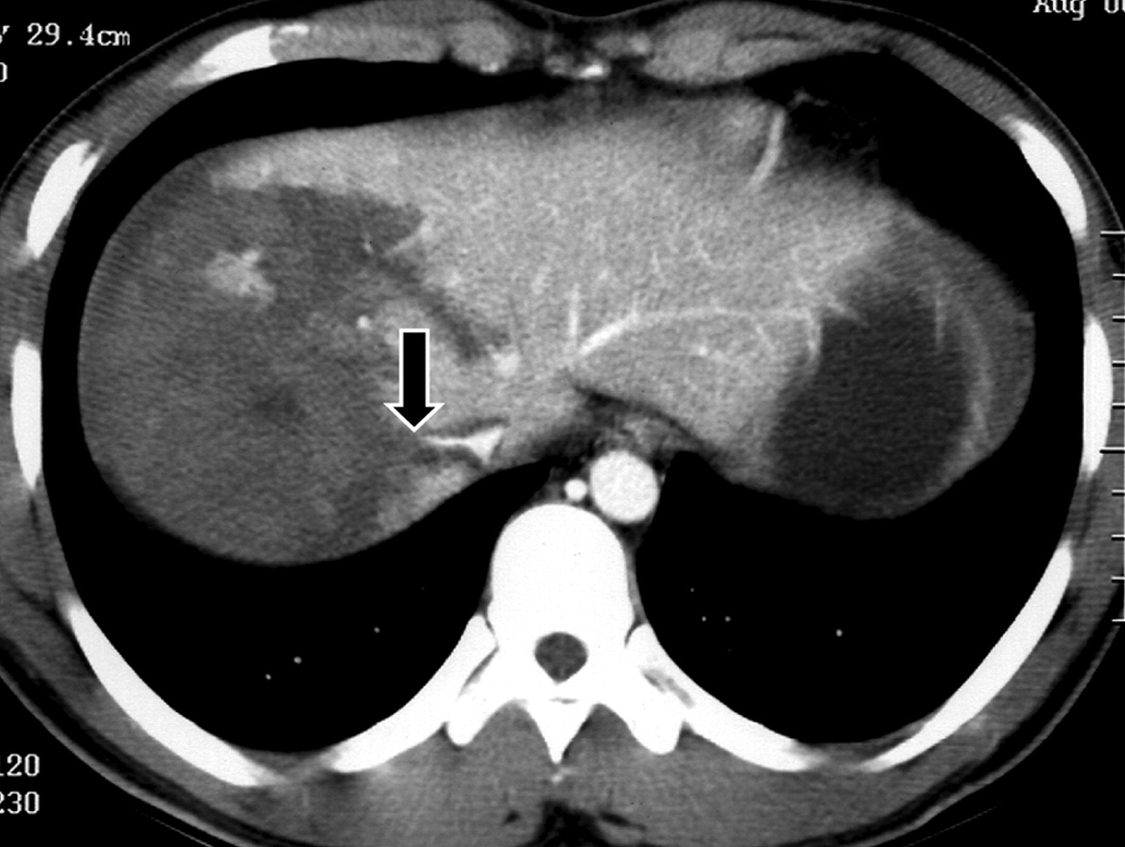
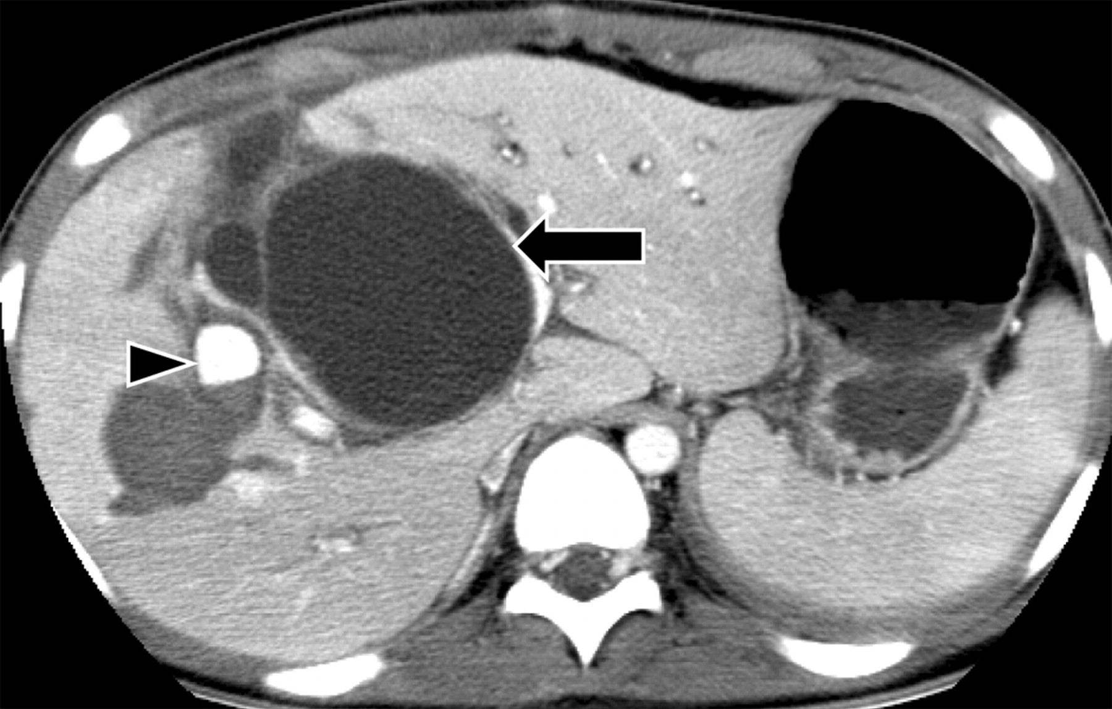
Introduction-IV: Injury Types
(a) Lacerations (arrow).
(b) Subcapsular Hematoma (arrow).
(c) Intraparenchymal Hematoma (arrow), Subcapsular Hematoma (arrowhead).
(d) Hepatic vein injury: Active bleeding within intraparenchymal hematoma.
(e) Hepatic venous injury: Lacerations extending to Inferior Vana Cava (IVC) and cutoff of right hepatic venous drainage (arrow).
(f) Biliary duct injury: Biloma (arrow), pseudoaneurysm (arrowhead).

Slide 7
Introduction-V: Injury Grading Scale
AAST (American Association for the Surgery of Trauma) Liver Injury Scale (2018 revision) [19]
WSES (World Society of Emergency Surgery) [20,21]
Liver trauma classification is based on AAST-OIS anatomic classification + hemodynamic status + associated injuries
Table 1.1: Liver Trauma Grading: AAST and WSES Grading System
AAST Grade | Imaging Criteria (CT Findings) | WSES Grade
I | Subcapsular hematoma <10% surface area | Grade I – Mild Hemodynamic status: Stable
 | Parenchymal laceration <1 cm depth
II | Subcapsular hematoma 10-50% surface area; intraparenchymal hematoma <10 cm in diameter
 | Laceration 1-3 cm in depth and ≤10 cm length
III | Subcapsular hematoma >50% surface area; ruptured subcapsular or parenchymal hematoma | Grade II – Moderate Hemodynamic status: Stable
 | Intrparenchymal hematoma >10 cm
 | Laceration >3 cm depth
 | Any injury in the presence of a liver vascular injury or active bleeding contained within liver parenchyma
IV | Parenchymal disruption involving 25-75% of a hepatic lobe | Grade III – Severe Hemodynamic status: Stable Grade IV – Severe; AAST Grades: I–V Hemodynamic status: Unstable
 | Active bleeding extending beyond the liver parenchyma into the peritoneum
V | Parenchymal disruption >75% of hepatic lobe
 | Juxtahepatic venous injury to include retrohepatic vena cava and central major hepatic veins

Slide 8
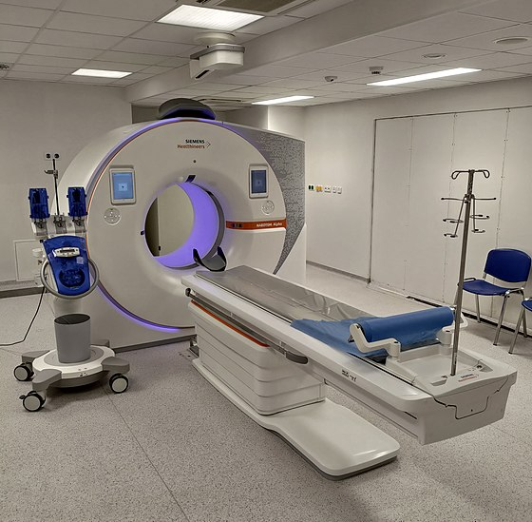
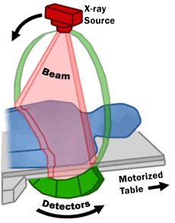
Introduction-VI: Imaging Modalities & Why Automation?
Contrast Enhanced Ultrasound (CEUS) [18]
Hemodynalically unstable patients
Contrast-enhanced Computed Tomography (CT) [18]
Gold standard: Sens./Spec.: 98%
Grade of injury
Vascular injuries
Associated injuries
Why automated assessment? [22]
CT limitations
Manual segmentation and grading: time consuming, introduce error for complex injuries.
Automated tools can:
Provide rapid, consistent, and accurate evaluations
Reduce burden on radiologist
Figure 1.5: CT Scanner
(Source:https://en.wikipedia.org/wiki/CT_scan

Slide 9
Literature Review
The literature review was conducted focusing on [23-42]
Liver trauma segmentation,
Grading of liver injuries,
Liver segmentation,
Spleen trauma segmentation,
Deep learning architectures employed in identifying liver tumor.
Datasets found during literature survey
Liver segmentation (Public dataset)
CHAOS challenge dataset,
SLIVER07 challenge dataset,
LiTS dataset.
Liver trauma segmentation and Grading of injuries
Private dataset from trauma centers.

Slide 10
Literature Review-I
Publication details | Purpose | Data | Key findings | Limitations and reviews
A deep learning framework for automated detection and quantitative assessment of liver trauma. Farzaneh et al. (2022) [23] | To automatically detect and segment traumatic regions Perform quantitative volumetric measure--ment of trauma regions | Private | Automated computation of percentage of liver parenchyma disrupted by trauma. Integrate human domain knowledge during post-processing to improve model's accuracy. | Only portal venous phase CT images considered. The presence of artifacts not considered in CT scans. Injuries like subcapsular hematoma and active bleeding not considered.
Added value of deep learning‑based liver parenchymal CT volumetry for predicting major arterial injury after blunt hepatic trauma: a decision tree analysis. Dreizin et al. (2021) [24] | Using LPDI in predicting major hepatic arterial injury (MHAI) Investigate the performance of LPDI in conjunction with volumetric CE through decision tree analysis for predicting MHAI. | Private | Usage of volumetric CE instead of binary assessment of CE yielded more precise result. Employed classification and regression tree (CART) analyses to generate decision rules. | The contrast extravasation volume was assessed using manual segmentation. No mention of artifacts/noise removal from CT scans. Only single phase was used in the study. Did not consider venous hepatic bleeding as an outcome.

Slide 11
Literature Review-II
Publication details | Purpose | Data | Key findings | Limitations and reviews
Automated quantitative assess- ment of pediatric blunt hepatic trauma by deep learning-based CT volumetry. Huang et al.(2022) [25] | Detect and segment trauma regions in paediatric CT scans. Perform quantitative volumetric measure--ment of trauma regions | Private | Both LPDI and trauma volume used to correlate with AAST grading. Using cutoff values for liver trauma volume and LPDI to delineate between low-grade and high-grade injuries. | Labelling was done using spherical brush tool instead of voxel-wise resulting in weak annotations. Limited dataset was used. Only single-phase CT images considered.
Toward automated interpretable AAST grading for blunt splenic injury. Chen et al (2022) [28] | Develop automated DL system to predict the AAST grade for blunt splenic injuries. | Private, ABPSA, SMSD (Medical Segment—tion decla—thon) | Noisy student algorithm used to identify and label injured spleens. Demonstrated a high level of accuracy in diagnosing high-grade (IV and V) injuries. Binary assessment of PSA and AB is considered rather than volumetric. | Quantification of vascular injury not considered. Performance of noisy-student algorithm heavily depends on the teacher model and can risk overfitting. The grading model is not effective in determining threshold for injury grades

Slide 12
Literature Review-III
Publication details | Purpose | Data | Key findings | Limitations and reviews
External Attention Assisted Multi-Phase Splenic Vascular Injury Segmentation With Limited Data. Zhou et al. (2021) [29] | To develop DL for segmenting splenic vascular injuries from multi-phase CT scans To address inter-patient variation (variability in shape, texture, size) and limited data | Private | Use of CycleGAN as synthetic augmentation necessitates careful hyper-parameter tuning The iterative process to improve learning of splenic vascular injuries depends on the quality of pseudo-labels. | The study is only limited to vascular injuries. Does not address multi-site CT scans Added complexity due to usage of CycleGAN and external attention mechanism. Effectiveness of synthetic data depends on the balance of real and synthetic data during training
PA-Net: A phase attention network fusing venous and arterial phase features of CT images for liver tumor segmentation. Liu et al (2023) [32] | Improve liver tumor segmentation by using multi-phase CT images. Address feature redundancy and spatial misalignment. | Private | Thick layered CT images can make image registration less effective. PA module efficiently fuses multi-phase CT image features and avoids feature redundancy | Limited dataset No explanation provided as to why the registration process is not very effective for thick CT scans

Slide 13
Literature Review-IV
Publication details | Purpose | Data | Key findings | Limitations and reviews
DA-Tran: Multiphase liver tumor segmentation with a domain-adaptive transformer network. Ni et al. (2023) [33] | To develop domain-adaptive transformer network for liver tumor segmentation | Private | Spatial misalignment not prioritized. Integration of phase information occurs only at deep level, which limits the model's ability to precisely delineate target boundaries affecting the segmentation. | High computational requirement of model’s architecture Lack of sensitivity to tumors with blurred margins and small-scale lesions
CT2Rep: Automated Radiology Report Generation for 3D Medical Imaging Hamamci et al. (2024) [43] | Automate radiology report generation for chest CT volumes | CT-RATE | Only ‘findings’ in clinical report are used for report generation. Natural language generation (NLG) and clinical efficacy (CE) metrics are employed to evaluate the effectiveness of automated radiology report generation | Focuses on only chest CT scans Does not provide specific details about the steps taken to process clinical reports

Slide 14
Research Gaps Identified
Lack of Multi-injury Detection
Limited work is reported on detecting and segmenting multiple liver injuries in one study with radiologist level accuracy.
Use of Multi-phasic Study
Current studies are primarily done on single phase CT imaging, while multi-phasic imaging can provide a richer insights to traumatic liver injuries.
Limited Automated Grading System
Although work has been done on volumetric assessment of liver trauma, very limited work has been carried out on grading the severity of the liver injury.
Lack of Decision Support System (DSS)
There is no major work carried out on designing an intuitive interface to automate the assessment of liver trauma.

Slide 15
Objectives
To design and develop an efficient framework to identify and segment the liver and traumatic regions of liver in CT scan.
To develop an automated module for quantitative assessment and severity grading of liver trauma.
To develop an end-to-end pipeline that integrates trauma segmentation and injury grading into an intuitive interface, for accurate and precise assessment of liver trauma.

Slide 16
Research Gaps to Objectives Mapping
Lack of Multi-injury Detection
Use of Multi-phasic Study
Limited Automated Grading System
Lack of DSS
To design and develop an efficient framework to identify and segment the liver and traumatic regions of liver in CT scan.
To develop an automated module for quantitative assessment and severity grading of liver trauma.
To develop an end-to-end pipeline that integrates trauma segmentation and injury grading into an intuitive interface, for accurate and precise assessment of liver trauma.

Slide 17
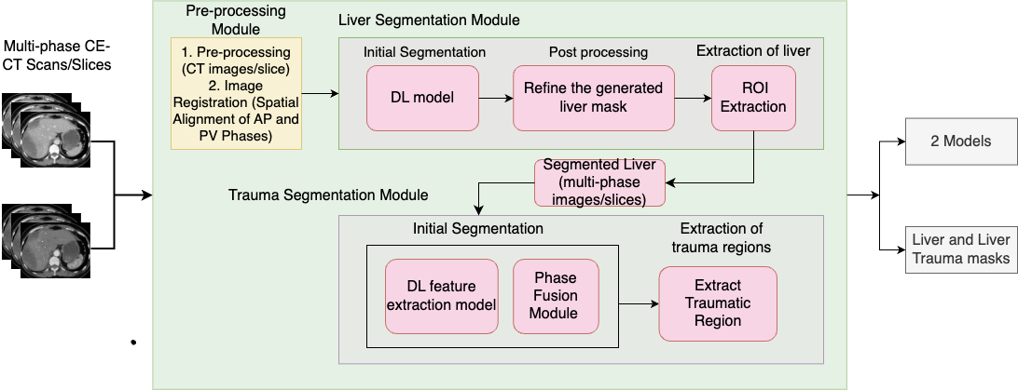
Research Methodology-Objective 1
Objective - 1: To design and develop models to identify and segment the liver and traumatic regions of liver in CT scans
Figure 5.1: Block Diagram of Liver Trauma Segmentation

Slide 18
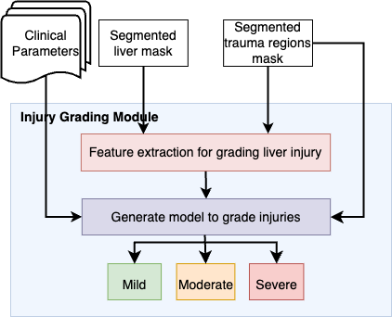
Research Methodology-Objective 2
Objective - 2: To develop an automated module for quantitative assessment and severity grading of liver trauma.
Figure 5.2: Block Diagram of Injury Grading Module

Slide 19
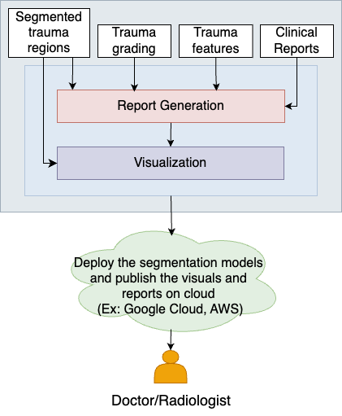
Research Methodology-Objective 3
Objective - 3: To develop an end-to-end pipeline that integrates trauma segmentation and injury grading into an intuitive interface, enabling accurate and precise assessment of liver trauma.
Figure 5.3: Block Diagram of Interface for Model Evaluation

Slide 20
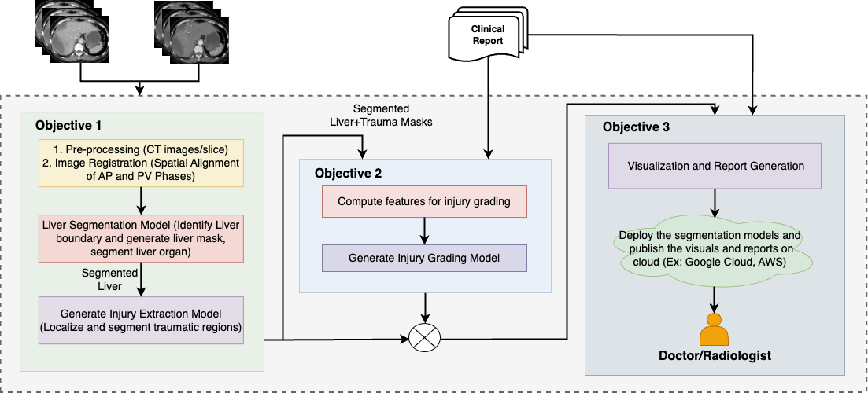
Research Methodology-Overall Workflow
Figure 5.4: Block Diagram of Decision Support System for Liver Trauma Assessment

Slide 21
Expected Outcomes
The proposed research should result in a decision support system that will provide:
precise segmentation, quantification, and grading of liver trauma in multi-phase CE-CT scans.
a user-friendly interface that will display trauma details, and generate clinical report
Findings shared in renowned journals, conference proceedings, and potential patents will be explored.

Slide 22
Importance of Proposed Research
Limited Research in India
Studies on liver trauma are minimal, mainly small-scale and single-center.
High-Risk Demographic
India shows a higher rate of hemorrhagic deaths from liver trauma, particularly among young men involved in road accidents.
Complexities of Liver Trauma
Hepatic vein and bile duct injuries risk secondary complications, underscoring the need for precise, timely diagnosis.
Challenges in Traditional Assessment:
Manual CT segmentation is time-consuming, subjective, and may not accurately quantify injury severity.
Potential of AI-Powered DSS:
A DSS with advanced imaging techniques and AI can enhance assessment accuracy, injury severity identification, and overall patient outcomes.

Slide 23
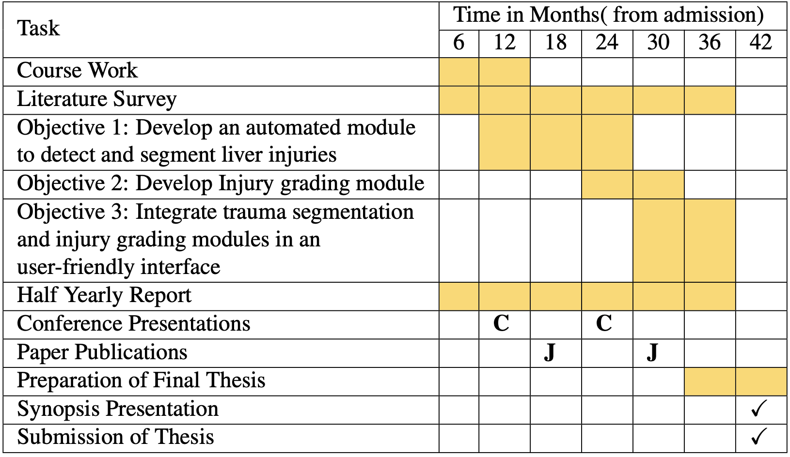
Research Time Plan

Slide 24
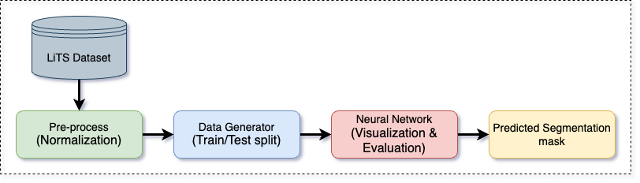
Pilot Study: Model & Dataset
Liver Segmentation Using Res32PACUNet Model [41]
Implemented liver segmentation on CT images of liver tumor taken from LiTS dataset using Res32PACUnet model.
Figure 9.1: Workflow of Res32PACUNet frameowork used in pilot study
Public Dataset: LiTS (Kaggle)
Extracted from LiTS – Liver Tumor Segmentation Challenge (LiTS17) organised in conjunction with ISBI 2017 and MICCAI 2017.
Training images: 38523; Test images: 3038; Image Resized: 256X256, PNG format

Slide 25
Pilot Study: Network Architecture & Experimental Setup
Network Architecture: ResNet32PACUNet
Extension of Unet model-> Residual block as backbone
Feature extraction-> multi-scale-> PAC (Pyramid Atrous Convolution)
Experimental Setup:
Training data: 80:20 split
Training: 10 epochs, batchsize: 32
Loss function: Binary cross entropy with logits loss
Optimizer: Adam, learning rate: 0.0001

Slide 26
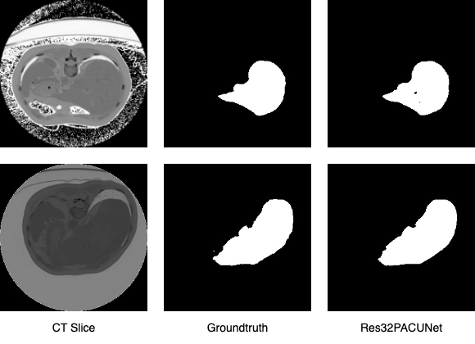
Pilot Study: Results
The study led to successful delineation of liver boundaries for each image in the test dataset.
Performance Evaluation:
Dice Similarity Coefficient: 97.64%
Precision: 98.08%
Recall: 97.40%
Figure 9.2: Different segmentation masks generated by the Res32PACUNet model

Slide 27
Expenses and Funding
The most suitable concepts for research funding will be studied and communicated.

Slide 28
References
[1] Taghavi S, Askari R. Liver Trauma - StatPearls - NCBI Bookshelf @ www.ncbi.nlm.nih.gov;. Available from: https://www.ncbi.nlm.nih.gov/ books/NBK513236/.
[2] Sibulesky L. Normal liver anatomy. Clin Liver Dis. 2013;2(SUPPL. 1):2012-4.
[3] Laing R, Edwards M, Faulkner T, Roberts K. Liver Trauma: Review of Management, and Patient Outcomes at Our Major Trauma Centre. J Gastrointest Hepatic Surg. 2022;5(1):67- 76.
[4] liver @ radiopaedia.org;. Available from: https://radiopaedia.org/articles/liver?lang=us.
[5] Abdel-Misih SRZ, Bloomston M. Liver Anatomy. Surg Clin North Am. 2010;90(4):643-53.
Available from: http://dx.doi.org/10.1016/j.suc.2010.04.017.
[6] Caseiro-Alves F, Seco M, Bernardes A. Liver Anatomy, Congenital Anomalies, and Normal Variants. In: Hamm B, Ros PR, editors. Abdom. Imaging. Springer-Verlag Berlin Heidelberg 2013; 2013. p. 983-99.
[7] Mahadevan V. Anatomy of the liver. Surg (UnitedKingdom). 2020;38(8):427-31. Available from: http://dx.doi.org/10.1016/j.mpsur.2014.10.004.
[8] Mitra V, Metcalf J. Functional anatomy and blood supply of the liver. Anaesth Intensive Care Med. 2012;13(2):52-3. Available from: http://dx.doi.org/10.1016/j. mpaic.2011.11.005.
[9] Saviano A, Ojetti V, Zanza C, Franceschi F, Longhitano Y, Martuscelli E, et al. Liver Trauma: Management in the Emergency Setting and Medico-Legal Implications. Diagnos- tics. 2022;12(6):1456.

Slide 29
References
[10] Roberts R, Sheth RA. Hepatic trauma. [article]. Ann Transl Med. 2021;9(14):1-9.
[11] Parks RW, Chrysos E, Diamond T. Management of liver trauma. British Journal of Surgery. 1999;86(9):1121-35.
[12] Badger SA, Barclay R, Campbell P, Mole DJ, Diamond T. Management of liver trauma [@article]. World J Surg. 2009;33(12):2522-37.
[13] Coccolini F, Cremonini C, Chiarugi M. Liver trauma. In: Textb. Emerg. Gen. Surg. Trauma. Non-traumatic Surg. Emergencies. Springer; 2023. p. 1415-30.
[14] Pillai AS, Kumar G, Pillai AK. Hepatic Trauma Interventions. In: Semin. Intervent. Radiol.. vol. 38. Thieme Medical Publishers, Inc.; 2021. p. 96-104.
[15] Alanezi T, Altoijry A, Alanazi A, Aljofan Z, Altuwaijri T, Iqbal K, et al. Management and Outcomes of Traumatic Liver Injury: A Retrospective Analysis from a Tertiary Care Center Experience. In: Healthc.. vol. 12. MDPI; 2024. p. 1-13
[16] Amato S, Bonnell L, Mohan M, Roy N, Malhotra A. Comparing trauma mortality of injured patients in India and the USA: A risk-adjusted analysis. Trauma Surg Acute Care Open. 2021;6(1):1-6.
[17] Sinha Y, Khajanchi MU, Prajapati RP, Dharap S, Soni KD, Kumar V, et al. Management of liver trauma in urban university hospitals in India: an observational multicentre cohort study. World J Emerg Surg. 2020;15(1):1-7.

Slide 30
References
[18] Yoon W, Yong YJ, Jae KK, Jeong JS, Hyo SL, Sang SS, et al. CT in blunt liver trauma. Radiographics. 2005;25(1):87-104.
[19] injury-scoring-scale @ www.aast.org;. Available from: https://www.aast.org/ resources-detail/injury-scoring-scale{#}liver.
[20] CoccoliniF, CatenaF, MooreEE, IvaturyR, BifflW, PeitzmanA, et al. WSES classification and guidelines for liver trauma [article]. World J Emerg Surg. 2016;11(1):1-8. Available from: http://dx.doi.org/10.1186/s13017-016-0105-2.
[21] Coccolini F, Coimbra R, Ordonez C, Kluger Y, Vega F, Moore EE, et al. Liver trauma: WSES 2020 guidelines. World J Emerg Surg. 2020;15:1-15.
[22] Brunese MC, Avella P, Cappuccio M, Spiezia S, Pacella G, Bianco P, et al. Future Perspectives on Radiomics in Acute Liver Injury and Liver Trauma. J Pers Med. 2024;14(6):572.
[23] Farzaneh N, Stein EB, Soroushmehr R, Gryak J, Najarian K. A deep learning frame- work for automated detection and quantitative assessment of liver trauma. BMC Med Imaging. 2022;22(1):1-13. Available from: https://doi.org/10.1186/ s12880-022-00759-9.
[24] Dreizin D, Chen T, Liang Y, Zhou Y, Paes F, Wang Y, et al. Added value of deep learning- based liver parenchymal CT volumetry for predicting major arterial injury after blunt hepatic trauma: a decision tree analysis. Abdom Radiol. 2021;46(6):2556-66. Available from: https://doi.org/10.1007/s00261-020-02892-x.

Slide 31
References
[25] Huang S, Zhou Z, Qian X, Li D, Guo W, Dai Y. Automated quantitative assessment of pediatric blunt hepatic trauma by deep learning-based CT volumetry. Eur J Med Res. 2022;27(1):1-11. Available from: https://doi.org/10.1186/ s40001-022-00943-1.
[26] Shen X, Zhou Y, Shi X, Zhang S, Ding S, Ni L, et al. The application of deep learning in abdominal trauma diagnosis by CT imaging. World J Emerg Surg. 2024;19(1):1-9.
[27] Cheng CT, Lin HH, Hsu CP, Chen HW, Huang JF, Hsieh CH, et al. Deep Learning for Automated Detection and Localization of Traumatic Abdominal Solid Organ Injuries on CT Scans. J Imaging Informatics Med. 2024;37(3):1113-23. Available from: https: //doi.org/10.1007/s10278-024-01038-5.
[28] Chen H, Unberath M, Dreizin D. Toward automated interpretable AAST grading for blunt splenic injury. Emerg Radiol. 2023;30(1):41-50. Available from: https://doi.org/ 10.1007/s10140-022-02099-1.
[29] Zhou Y, Dreizin D, Wang Y, Liu F, Shen W, Yuille AL. External Attention Assisted Multi-Phase Splenic Vascular Injury Segmentation with Limited Data. IEEE Trans Med Imaging. 2022;41(6):1346-57.
[30] Chen Y, Zheng C, Zhang W, Lin H, Chen W, Zhang G, et al. MS-FANet:Multi-scalefeature attention network for liver tumor segmentation. Comput Biol Med. 2023;163(June):107208. Available from: https://doi.org/10.1016/j.compbiomed.2023.107208.
[31] Jiang L, Ou J, Liu R, Zou Y, Xie T, Xiao H, et al. RMAU-Net: Residual Multi- Scale Attention U-Net For liver and tumor segmentation in CT images. Comput Biol Med. 2023;158(March):106838. Available from: https://doi.org/10.1016/j. compbiomed.2023.106838.

Slide 32
References
[32] Liu Z, Hou J, Pan X, Zhang R, Shi Z. PA-Net: A phase attention network fusing venous and arterial phase features of CT images for liver tumor segmentation. Comput Methods Programs Biomed. 2024;244(October 2023):107997. Available from: https://doi. org/10.1016/j.cmpb.2023.107997.
[33] Ni Y, Chen G, Feng Z, Cui H, Metaxas D, Zhang S, et al. DA-Tran: Multiphase liver tumor segmentation with a domain-adaptive transformer network. Pattern Recognit. 2024;149(March 2023):110233. Available from: https://doi.org/10.1016/j. patcog.2023.110233.
[34] Kuang H, Yang X, Li H, Wei J, Zhang L. Adaptive Multiphase Liver Tumor Segmentation With Multiscale Supervision. IEEE Signal Process Lett. 2024;31:426-30.
[35] Hu C, Xia T, Cui Y, Zou Q, Wang Y, Xiao W, et al. Trustworthy multi-phase liver tumor segmentation via evidence-based uncertainty. Eng Appl Artif Intell. 2024;133(PC):108289. Available from: https://doi.org/10.1016/j.engappai.2024.108289.
[36] Kushnure DT, Tyagi S, Talbar SN. LiM-Net: Lightweight multi-level multiscale network with deep residual learning for automatic liver segmentation in CT images. Biomed Signal Process Control. 2023;80(P1):104305. Available from: https://doi.org/10. 1016/j.bspc.2022.104305.
[37] Zhou Y, Kong Q, Zhu Y, Su Z. MCFA-UNet: Multiscale Cascaded Feature Attention U-Net for Liver Segmentation. Irbm. 2023;44(4):100789. Available from: https: //doi.org/10.1016/j.irbm.2023.100789.
[38] Li Y, Zou B, Dai P, Liao M, Bai HX, Jiao Z. AC-E Network: Attentive Context-Enhanced Network for Liver Segmentation. IEEE J Biomed Heal Informatics. 2023;27(8):4052-61.

Slide 33
References
[39] Dickson J, Linsely A, Nineta RJA. An integrated 3D-sparse deep belief net- work with enriched seagull optimization algorithm for liver segmentation. Mul- timed Syst. 2023;29(3):1315-34. Available from: https://doi.org/10.1007/ s00530-023-01056-3.
[40] Chen Y, Zheng C, Zhou T, Feng L, Liu L, Zeng Q, et al. A deep residual attention-based U-Net with a biplane joint method for liver segmentation from CT scans. Comput Biol Med. 2023;152(September 2022):106421. Available from: https://doi.org/10. 1016/j.compbiomed.2022.106421.
[41] Ansari MY, Yang Y, Balakrishnan S, Abinahed J, Al-Ansari A, Warfa M, et al. A lightweight neural network with multiscale feature enhancement for liver CT segmentation. Sci Rep. 2022;12(1):1-12.
[42] Han L, Chen Y, Li J, Zhong B, Lei Y, Sun M. Liver segmentation with 2.5D perpendicular UNets. Comput Electr Eng. 2021;91(March):107118. Available from: https://doi. org/10.1016/j.compeleceng.2021.107118.
[43] Hamamci, I.E., Er, S., Menze, B. (2024). CT2Rep: Automated Radiology Report Generation for 3D Medical Imaging. In: Linguraru, M.G., et al. Medical Image Computing and Computer Assisted Intervention – MICCAI 2024. MICCAI 2024. Lecture Notes in Computer Science, vol 15012. Springer, Cham. https://doi.org/10.1007/978-3-031-72390-2_45

Slide 34
Course Work Details
S. No. | Title of Course Work | Credits | Status
1 | Advanced Research Methodology (ARM) | 4 | In Progress (IP)
2 | Research and Publication Ethics (RPE) | 2 | Completed
3 | Medical Image Processing (Customized-7007) | 3 | To Be Taken (TBT)
4 | Deep Learning for Medical Image Processing (Customized-7008) | 4 | To Be Taken (TBT)

Slide 35
Thank You

